Slide 1
PYTHON FOR DATA · 40 MIN
Data Visualization
matplotlib, seaborn and pandas plotting · Unit 4
matplotlib
Seaborn
pandas
Customize
Figure and Axes
Statistical plots
Plots from data
Labels and saving
plt.subplots
sns.histplot
df.plot
ax.set savefig

Slide 2
Three Layers of Plotting
~2 min
Each layer builds on matplotlib.
1
matplotlib
2
Seaborn
Figures and Axes with full control.
Statistical plots from a DataFrame.
plt.subplots ax.plot
histplot boxplot heatmap
3
pandas
4
Customize
Quick plots straight from your data.
Titles, labels, legends and saving.
df.plot(kind=...)
ax.set legend savefig
seaborn and pandas return matplotlib Axes, so you can tune any plot.

Slide 3
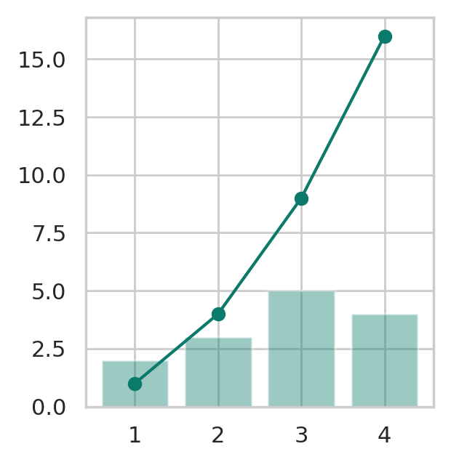
Figure and Axes
~4 min
The matplotlib object model.
import matplotlib.pyplot as plt
x = [1, 2, 3, 4]
fig, ax = plt.subplots()
ax.plot(x, [1, 4, 9, 16], marker="o")
ax.bar(x, [2, 3, 5, 4], alpha=0.4)
plt.show()
Plot
Figure and Axes
Draw on ax
The figure is the canvas. An Axes is one plot on it.
ax.plot, ax.bar, ax.scatter and ax.hist each add one layer.

Slide 4
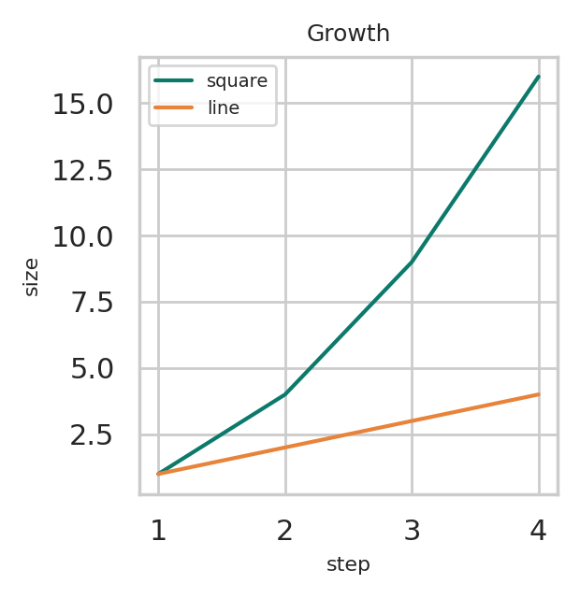
Labels and Legend
~4 min
Make the plot readable.
x = [1, 2, 3, 4]
fig, ax = plt.subplots()
ax.plot(x, [1, 4, 9, 16], label="square")
ax.plot(x, [1, 2, 3, 4], label="line")
ax.set(title="Growth", xlabel="step",
ylabel="size", xticks=x)
ax.legend()
Plot
ax.set
label, legend
Sets title, labels, limits and ticks in one call.
Give each line a label. ax.legend() then draws the key.

Slide 5
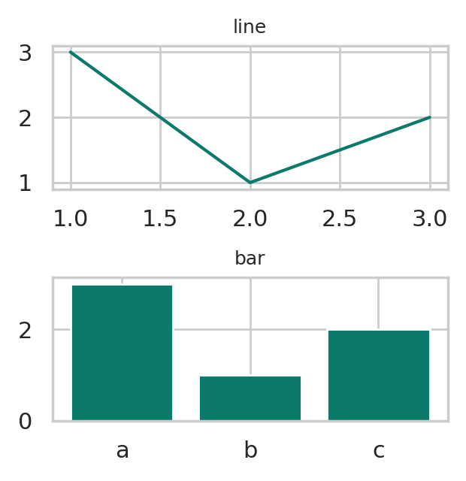
Subplots and Saving
~4 min
A grid of Axes in one figure.
fig, axs = plt.subplots(2, 1)
axs[0].plot([1, 2, 3], [3, 1, 2])
axs[0].set_title("line")
axs[1].bar(["a", "b", "c"], [3, 1, 2])
axs[1].set_title("bar")
fig.tight_layout()
fig.savefig("plots.png", dpi=150)
Plot
Array of Axes
tight_layout
subplots(rows, cols) returns Axes you index like a list.
Stops overlaps. savefig writes png, pdf or svg.

Slide 6
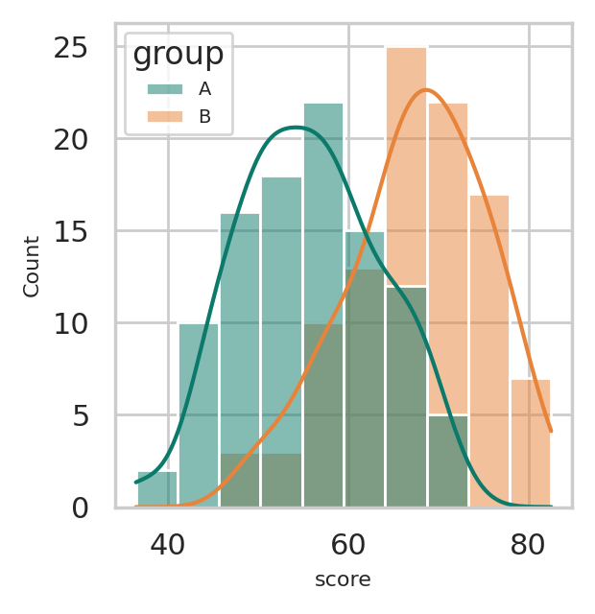
Seaborn: Distributions
~4 min
Seaborn works on a whole DataFrame.
import numpy as np, pandas as pd, seaborn as sns
rng = np.random.default_rng(0)
a, b = rng.normal(55, 8, 100), rng.normal(68, 8, 100)
df = pd.DataFrame({"group": ["A"] * 100 + ["B"] * 100,
"score": np.r_[a, b]})
sns.histplot(df, x="score", hue="group",
kde=True)
Plot
hue
kde=True
Splits the data by a column and colours each group.
Adds a smooth density curve over the histogram.

Slide 7
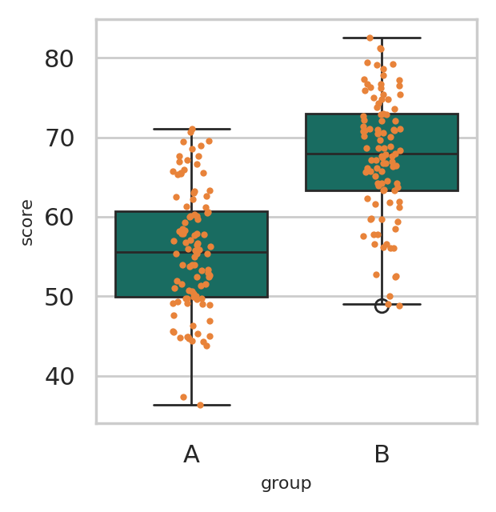
Seaborn: Compare Groups
~4 min
Categorical plots.
import numpy as np, pandas as pd, seaborn as sns
rng = np.random.default_rng(0)
a, b = rng.normal(55, 8, 100), rng.normal(68, 8, 100)
df = pd.DataFrame({"group": ["A"] * 100 + ["B"] * 100,
"score": np.r_[a, b]})
sns.boxplot(df, x="group", y="score")
sns.stripplot(df, x="group", y="score", size=3)
Plot
boxplot
Layer plots
Shows the median, quartiles and outliers of each group.
A stripplot on top shows every point. barplot shows means.

Slide 8
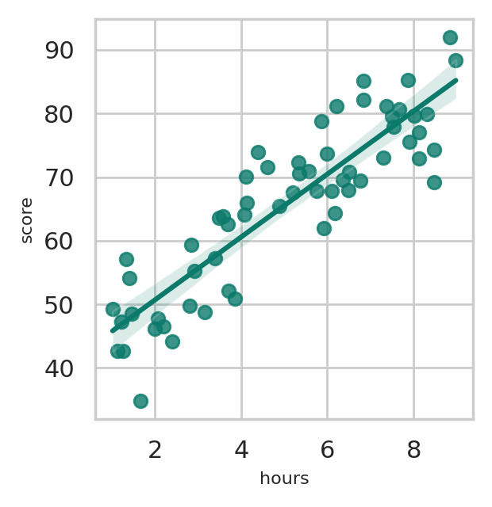
Seaborn: Relationships
~4 min
A scatter plot with a fitted line.
import numpy as np, pandas as pd, seaborn as sns
rng = np.random.default_rng(0)
hours = rng.uniform(1, 9, 60)
df = pd.DataFrame({"hours": hours,
"score": 40 + 5 * hours + rng.normal(0, 6, 60)})
sns.regplot(data=df, x="hours", y="score")
Plot
regplot
scatterplot
Draws the points, a fitted line and its confidence band.
Use hue and size to add more columns to one plot.

Slide 9
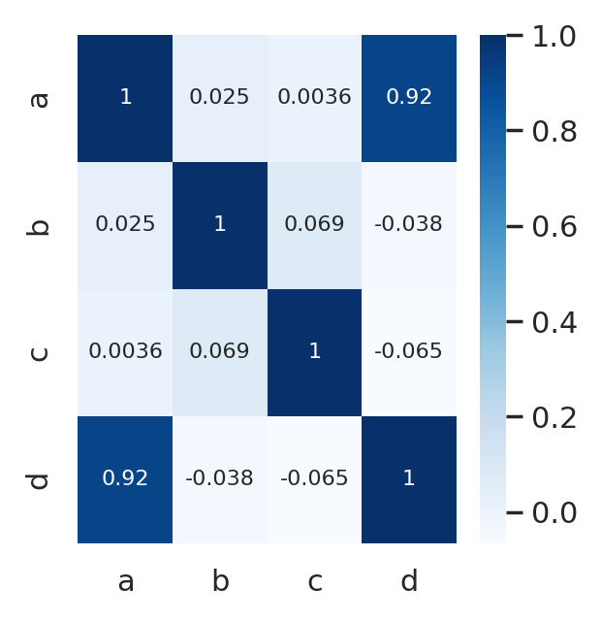
Seaborn: Heatmap
~4 min
See every correlation at once.
import numpy as np, pandas as pd, seaborn as sns
rng = np.random.default_rng(0)
df = pd.DataFrame(rng.normal(size=(100, 3)),
columns=["a", "b", "c"])
df["d"] = df["a"] * 2 + rng.normal(size=100)
sns.heatmap(df.corr(), annot=True, cmap="Blues")
Plot
corr()
annot, cmap
Builds the table of correlations between numeric columns.
annot=True prints each value. cmap sets the colours.

Slide 10
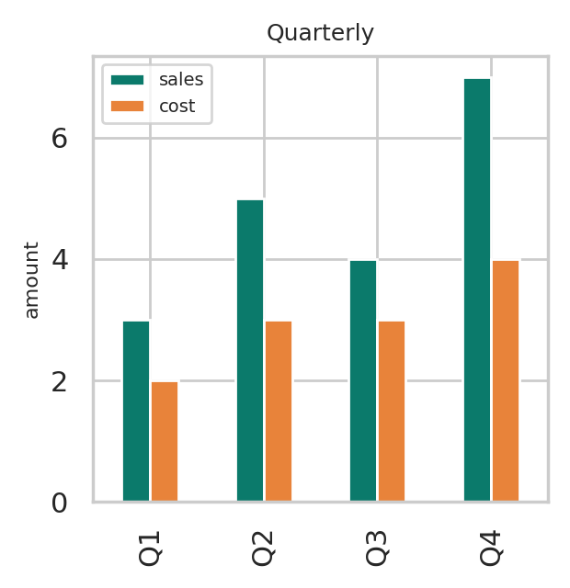
pandas: df.plot
~4 min
df.plot wraps matplotlib.
import pandas as pd
df = pd.DataFrame({"sales": [3, 5, 4, 7],
"cost": [2, 3, 3, 4]},
index=["Q1", "Q2", "Q3", "Q4"])
ax = df.plot(kind="bar", title="Quarterly")
ax.set_ylabel("amount")
Plot
df.plot
Returns an Axes
One series per column, with the index on the x axis.
Call set_ylabel and other matplotlib methods on ax.

Slide 11
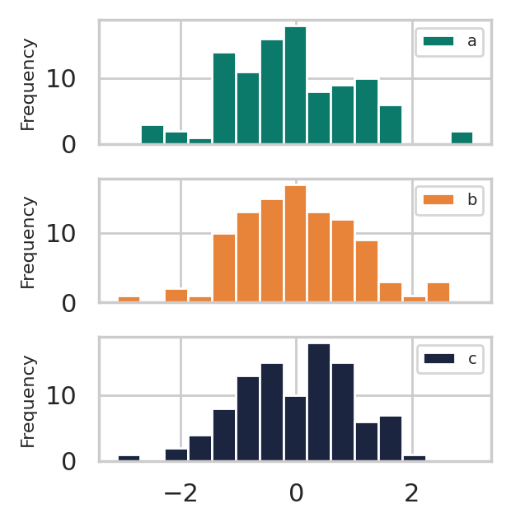
pandas: Other Kinds
~4 min
Change kind, keep the same call.
import numpy as np, pandas as pd
rng = np.random.default_rng(0)
df = pd.DataFrame(rng.normal(size=(100, 3)),
columns=["a", "b", "c"])
df.plot(kind="hist", bins=15, subplots=True,
sharex=True)
Plot
kind
subplots=True
line, bar, barh, hist, box, kde, area, scatter and pie.
One panel per column. scatter takes x= and y= columns.

Slide 12
Plotting Cheat Sheet
~2 min
Match the task to the tool.
Task | Tool
One plot on a figure | fig, ax = plt.subplots()
Several panels | plt.subplots(rows, cols)
Titles, labels, legend | ax.set(...), ax.legend()
Save the figure | fig.savefig("name.png")
Distributions | sns.histplot, sns.kdeplot
Compare groups | sns.boxplot, barplot, violinplot
Relationships | sns.scatterplot, regplot, heatmap
Quick plots from data | df.plot(kind=...)
Label every axis. Pick the plot that matches the question.

